Slide 1
goyaPhone
The phone for salespeople

Slide 2
How do you find
a customer?
www.goyaphone.eu

Slide 3
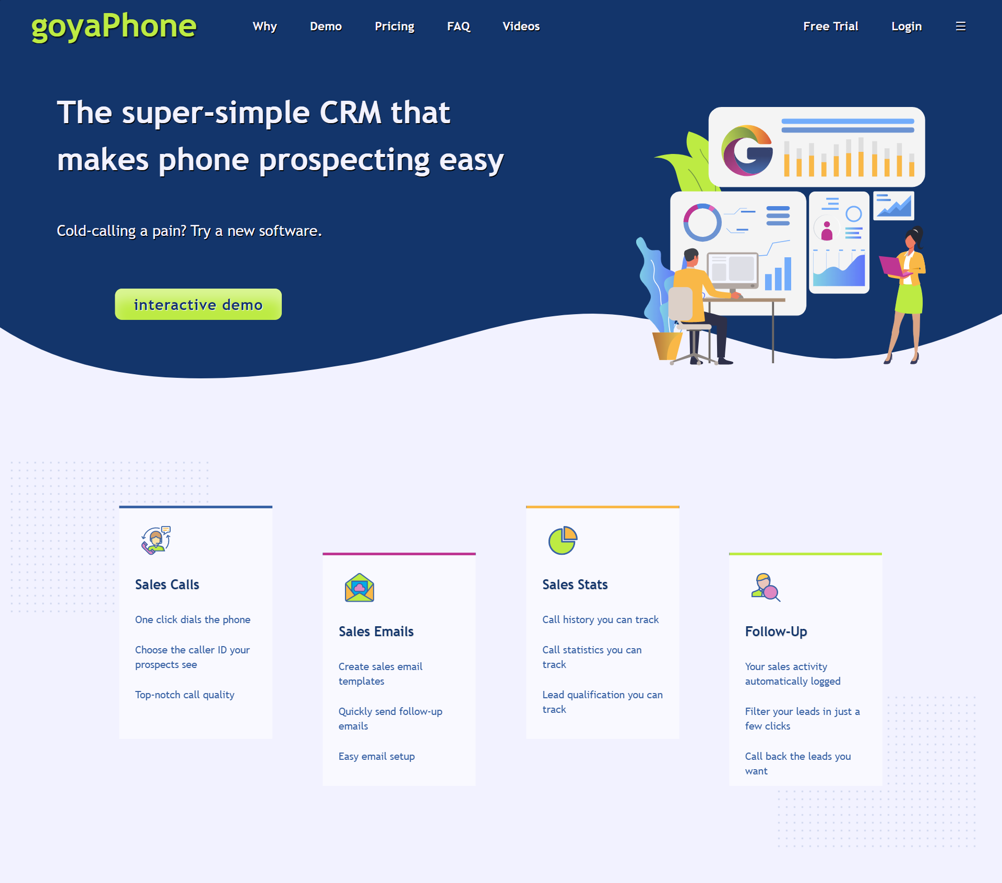

Slide 4
A CRM designed for prospecting
www.goyaphone.eu

Slide 5
No manual
data-entry

Slide 6
A CRM designed for the follow-up
www.goyaphone.eu

Slide 7
Filter the call history: possible + easy

Slide 8
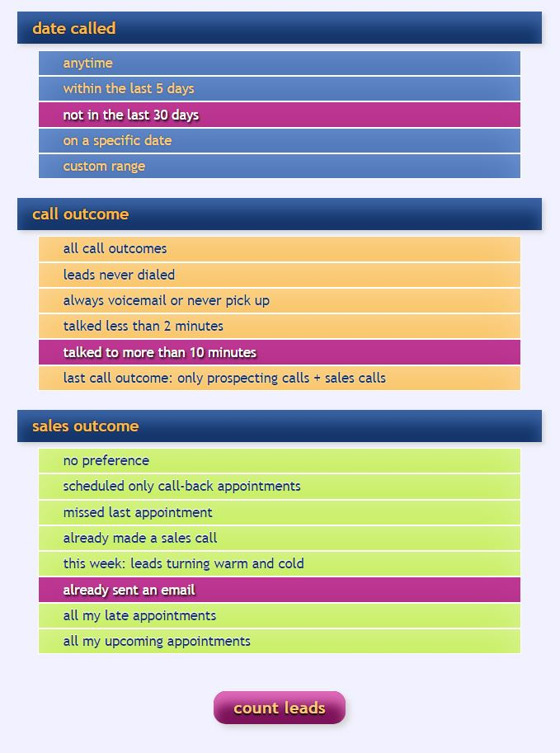
Filter leads: the memory for salespeople

Slide 9
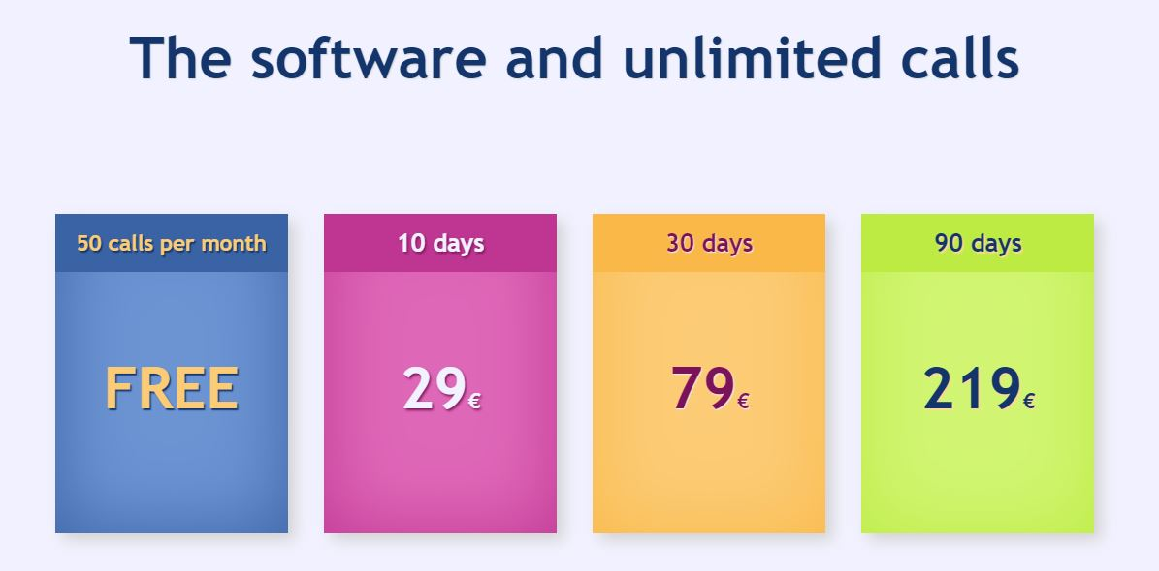
Self-service Saas CRM
www.goyaphone.eu/pricing

Slide 10
Intellectual Property
www.goyaphone.eu

Slide 11
Single founder self-taught
www.goyaphone.eu

Slide 12
online advertising
WORLDWIDE
www.goyaphone.eu

Slide 13
funding
1 million euros
www.goyaphone.eu/ads

Slide 14
4K / day on ads
for 200 days
www.goyaphone.eu/ads

Slide 15
10,000 users
in 200 days
www.goyaphone.eu

Slide 20
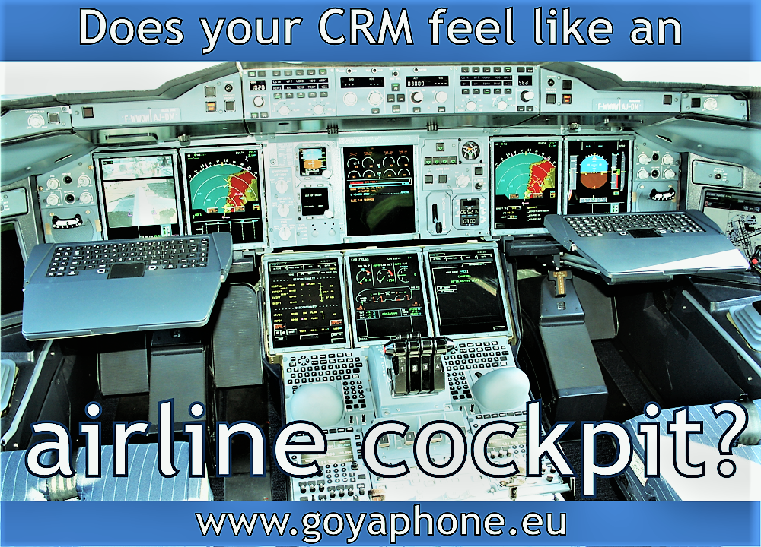

Slide 22
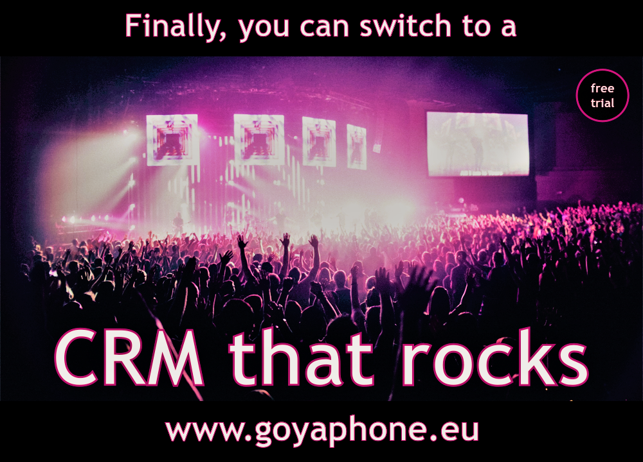

Slide 23
