Slide 1
goyaPhone
The phone for salespeople

Slide 2
How do you find
a customer?

Slide 3
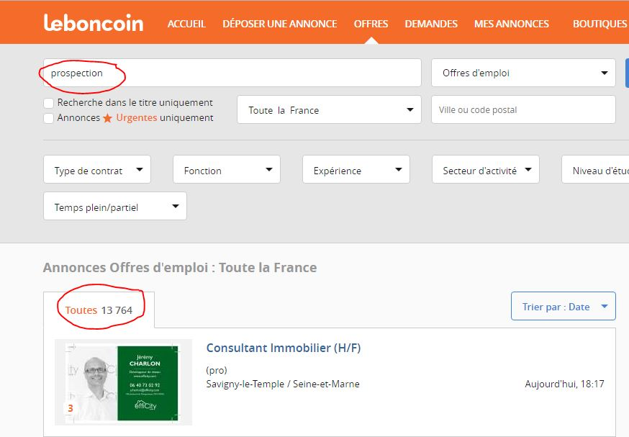
Inside sales = telephone prospecting

Slide 4
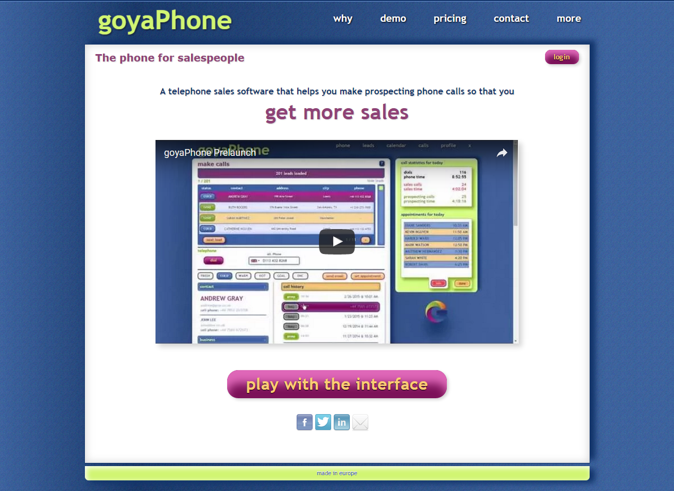

Slide 5
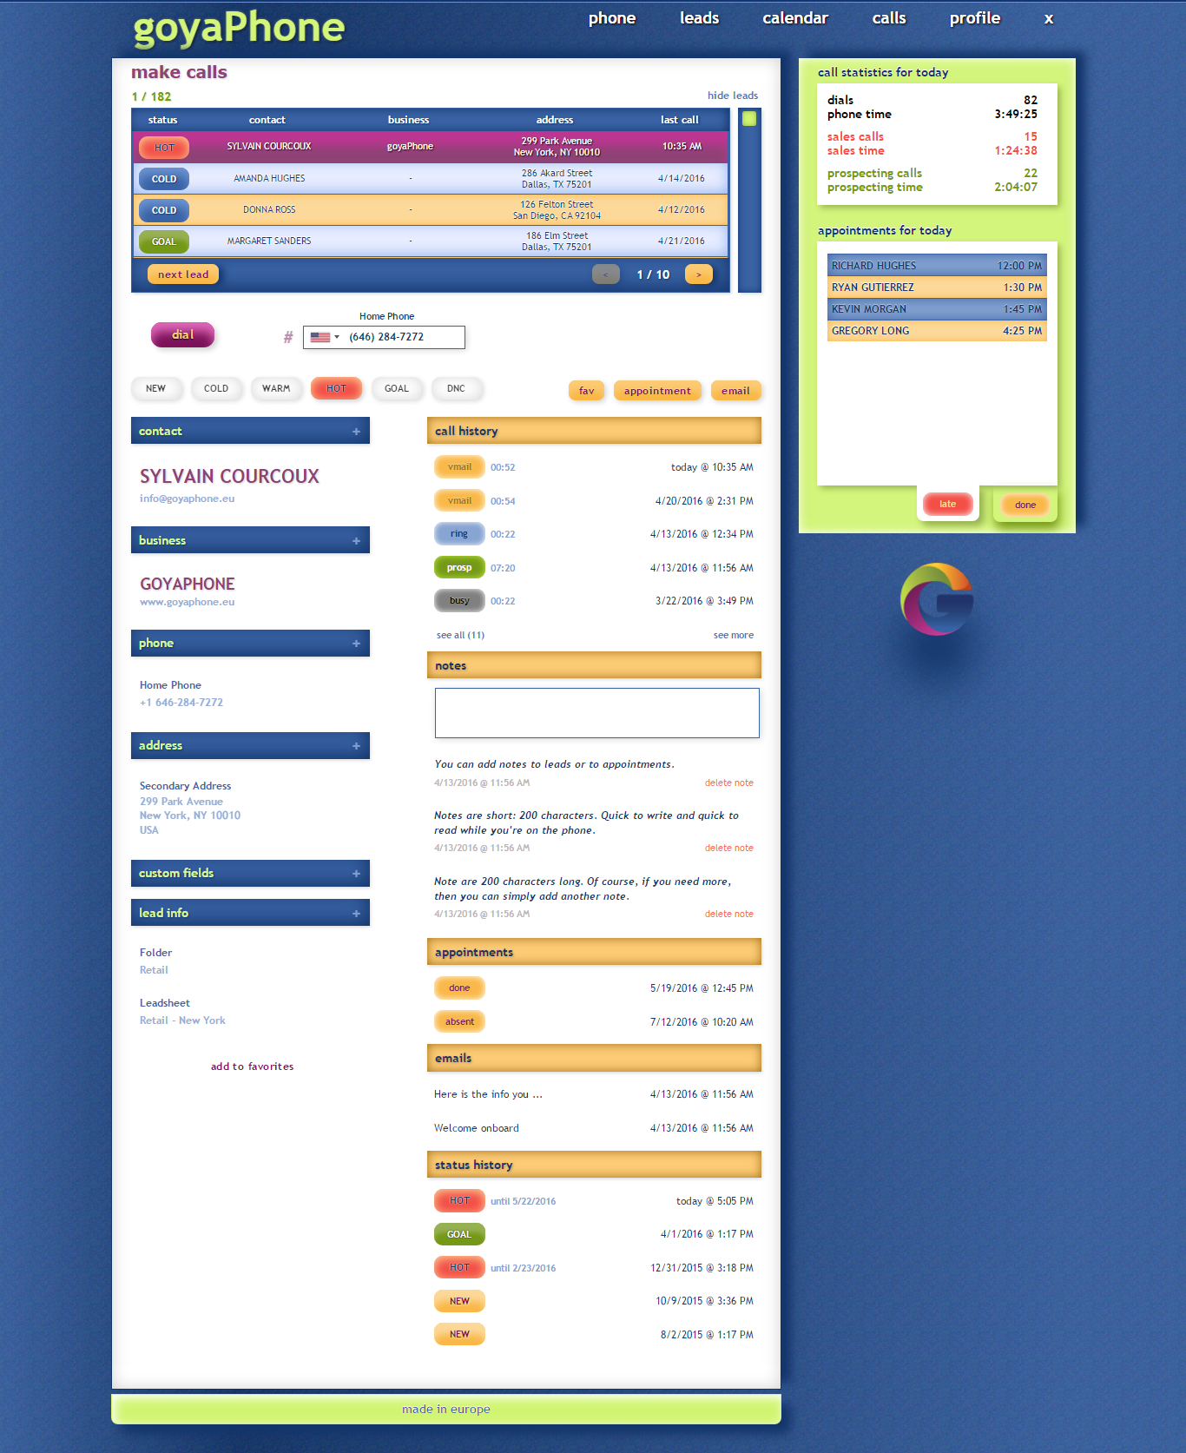

Slide 6
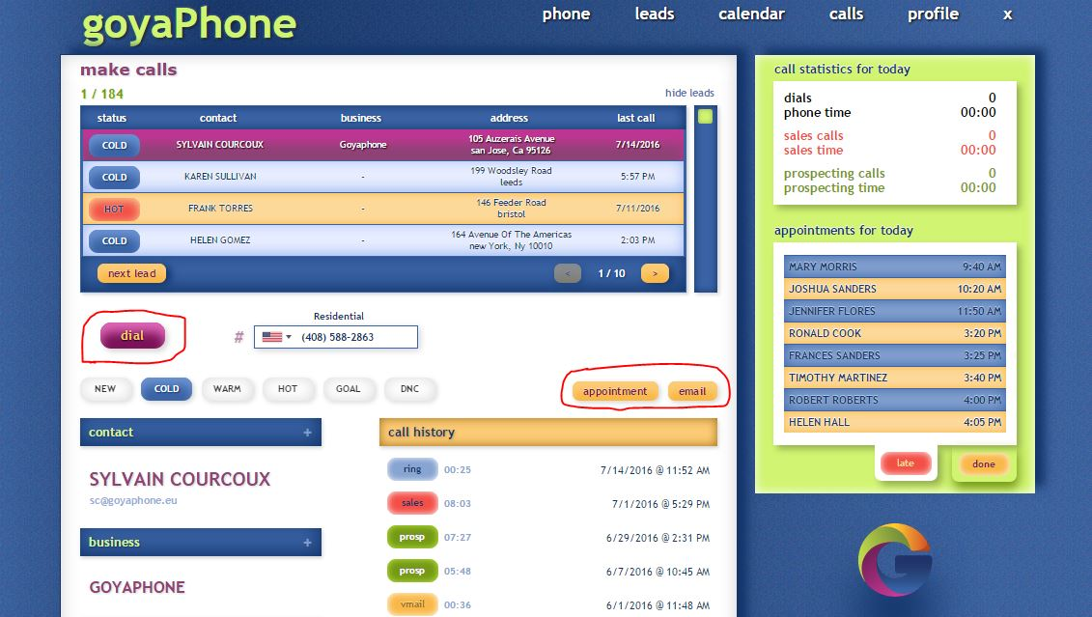
Prospecting = calls + emails + appointments

Slide 7
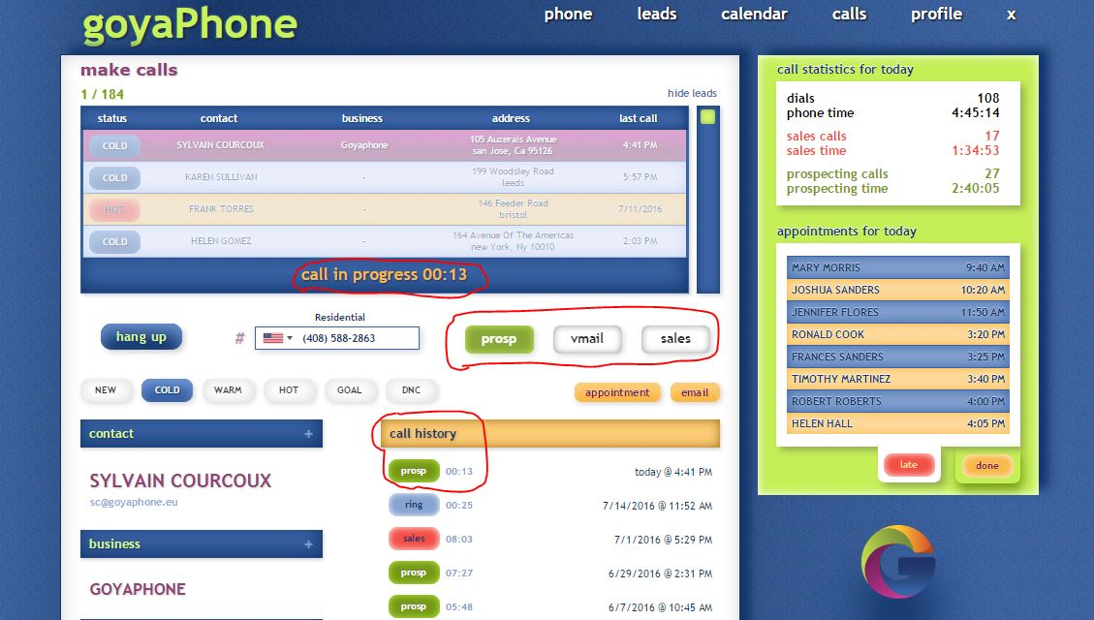
No data entry = reduced frustration

Slide 8
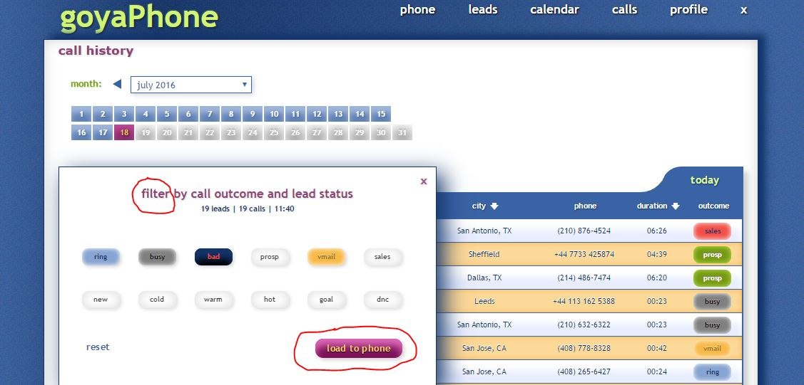
Follow-up: just a few clicks

Slide 9
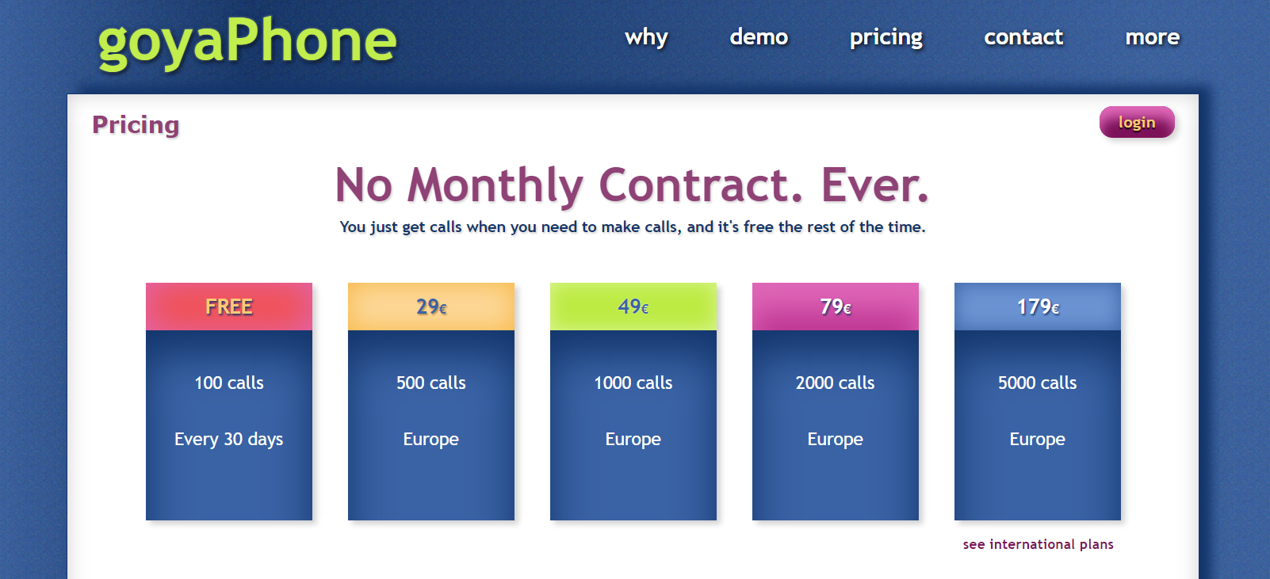
SAAS business model

Slide 10
12K phone calls in beta
Lots of code and UX bug fixes
Ready to launch soon

Slide 11
Look at competition from the perspective of the buyer

Slide 12
goyaPhone
Seeking 250K – 500K

